Slide 1
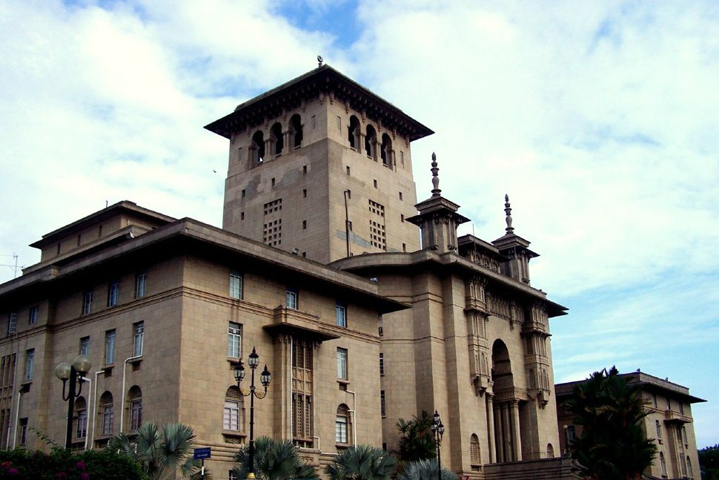
DATA-DRIVEN HERITAGE PRESERVATION: MACHINE LEARNING APPLICATIONS IN MICROCLIMATE MONITORING – JOHOR BAHRU'S HERITAGE CONTEXT
Go to Home

Slide 2





DATA-DRIVEN HERITAGE PRESERVATION: MACHINE LEARNING APPLICATIONS IN MICROCLIMATE MONITORING – JOHOR BAHRU'S HERITAGE CONTEXT
HOME
TOTAL HERITAGE
TEMPERATURE
HUMIDITY
PRESSURE
WIND SPEED
12
01
01
01
02
HERITAGE 1
HERITAGE 2
HERITAGE 3
HERITAGE 4
30 ˚C
45%
30 ˚C
75%
30 ˚C
45%
30 ˚C
45%
TEMPERATURE
HUMIDITY
TEMPERATURE
HUMIDITY
TEMPERATURE
HUMIDITY
TEMPERATURE
HUMIDITY
1070 hPa
18 km/h
870 hPa
18 km/h
860 hPa
18 km/h
830 hPa
100 km/h
PRESSURE
WIND SPEED
PRESSURE
WIND SPEED
PRESSURE
WIND SPEED
PRESSURE
WIND SPEED
MORE DETAILS >
MORE DETAILS >
MORE DETAILS >
MORE DETAILS >
HERITAGE 5
HERITAGE 6
HERITAGE 7
HERITAGE 8
30 ˚C
45%
30 ˚C
45%
60 ˚C
45%
30 ˚C
45%
TEMPERATURE
HUMIDITY
TEMPERATURE
HUMIDITY
TEMPERATURE
HUMIDITY
TEMPERATURE
HUMIDITY
870 hPa
18 km/h
910 hPa
18 km/h
870 hPa
120 km/h
890 hPa
18 km/h
PRESSURE
WIND SPEED
PRESSURE
WIND SPEED
PRESSURE
WIND SPEED
PRESSURE
WIND SPEED
MORE DETAILS >
MORE DETAILS >
MORE DETAILS >
MORE DETAILS >

Slide 3
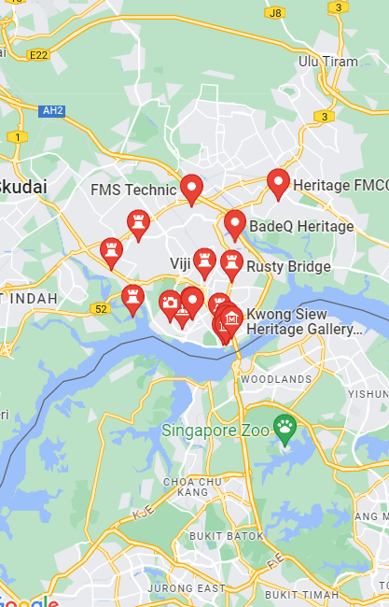
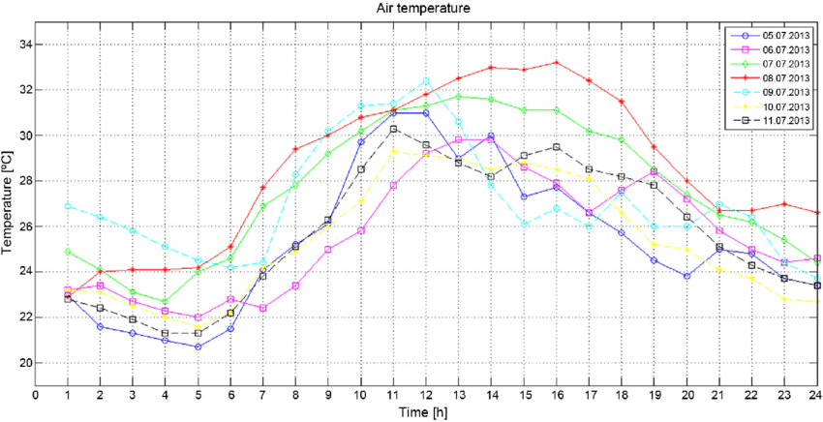
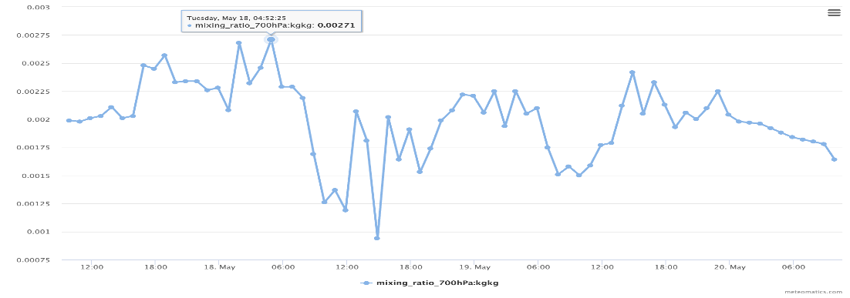

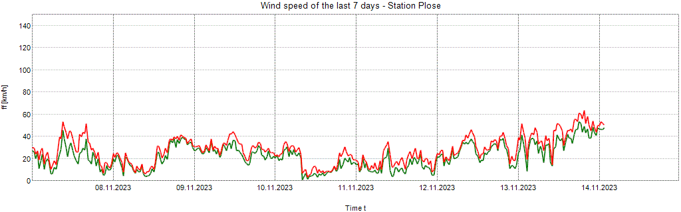
DATA-DRIVEN HERITAGE PRESERVATION: MACHINE LEARNING APPLICATIONS IN MICROCLIMATE MONITORING – JOHOR BAHRU'S HERITAGE CONTEXT
HERITAGE 1
YEAR
MONTH
DAY
TEMPERATURE
HUMIDITY
30 ˚C
45%
30 ˚C
PRESSURE
WIND SPEED
980 hPa
18 km/h
AVERAGE PRESSURE
AVERAGE PRESSURE
AVERAGE HUMIDITY
980 hPa
60
980 hPa
1070 hPa
40
890 hPa
1160 hPa
20
80
800 hPa
0
100
ALERT
PREDICTIVE MAINTENANCE

